Slide 1
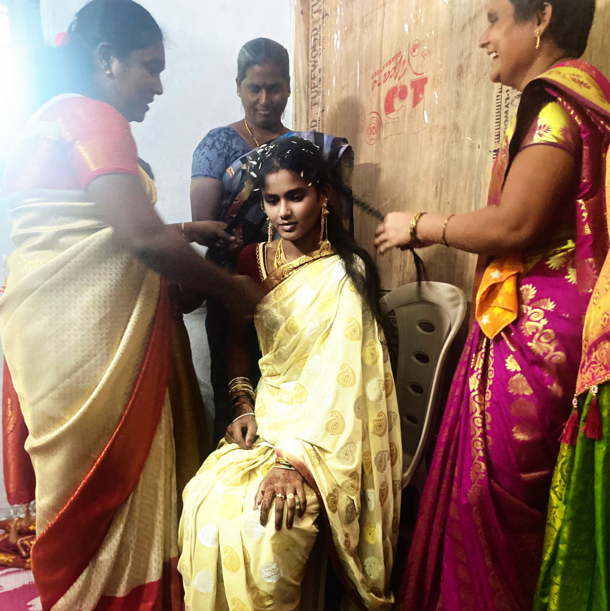
The dowry paid
John 14:16 You didn’t choose me, but I’ve chosen and commissioned you to go into the world[b] to bear fruit. And your fruit will last, because whatever you ask of my Father, for my sake,[c] he will give it to you!

Slide 2
The dowry paid
1 Corinthians 1:28 He chose the lowly, the laughable in the world’s eyes—nobodies—so that he would shame the somebodies. For he chose what is regarded as insignificant in order to supersede what is regarded as prominent,

Slide 3
The dowry paid
Ephesians 5:25 And to the husbands, you are to demonstrate love for your wives with the same tender devotion that Christ demonstrated to his bride. For he died for her, sacrificing himself
(He paid for her, redeemed her)

Slide 4
The dowry paid
Isaiah 49:17“Your builders hurry; Your destroyers and devastators
Will leave you. 18“Raise your eyes and look around;All of them gather together, they come to you. As I live,” declares the LORD,
“You will certainly put them all on as jewelry and bind them on as a bride.

Slide 5
The dowry paid
Genesis 24:10 Then the servant left, taking with him ten of his master’s camels loaded with all kinds of good things from his master. He set out for Aram Naharaim and made his way to the town of Nahor.

Slide 6
The dowry paid
Genesis 24:14 May it be that when I say to a young woman, ‘Please let down your jar that I may have a drink,’ and she says, ‘Drink, and I’ll water your camels too’—let her be the one you have chosen for your servant Isaac. By this I will know that you have shown kindness to my master.”

Slide 7
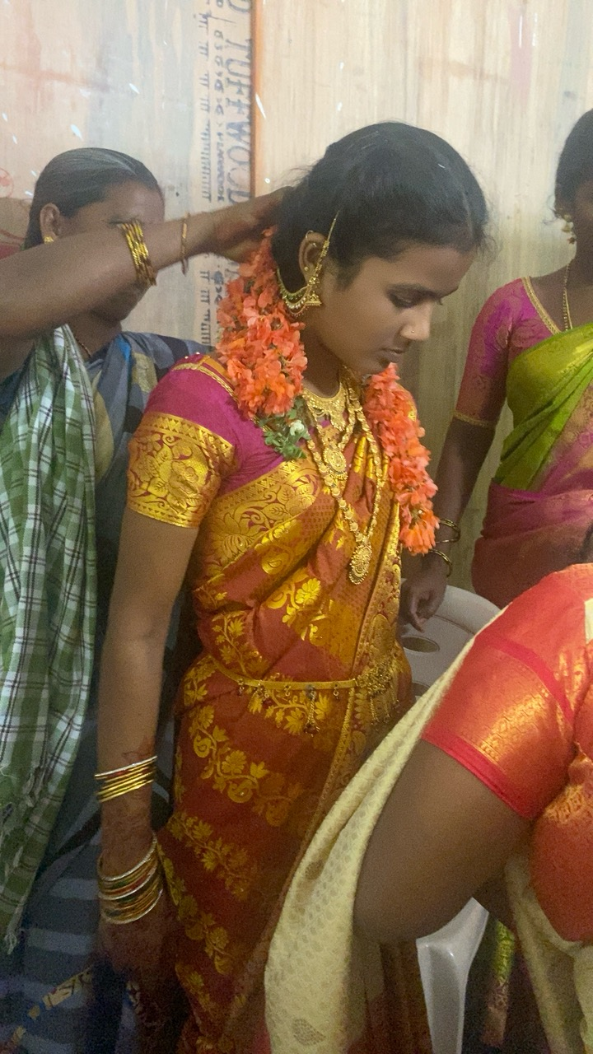
The dowry paid
Genesis 24:46 “She quickly lowered her jar from her shoulder and said, ‘Drink, and I’ll water your camels too.’ So I drank, and she watered the camels also. 47 “I asked her, ‘Whose daughter are you?’ “She said, ‘The daughter of Bethuel son of Nahor, whom Milkah bore to him.’
“Then I put the ring in her nose and the bracelets on her arms,

Slide 8
The dowry paid
Genesis 24:53 Then the servant brought out gold and silver jewelry and articles of clothing and gave them to Rebekah; he also gave costly gifts to her brother and to her mother.
1. Ring on her nose
2. Bracelets on her arms
3. Gold Articles
4. Silver Articles
5. Articles of Clothing

Slide 9
The dowry paid
Ephesians 4:11 And he has appointed some with grace to be apostles, and some with grace to be prophets, and some with grace to be evangelists,[a] and some with grace to be pastors,[b] and some with grace to be teachers.[c]
1. Ring on her nose (prophets)
2. Bracelets on her arms (pastors)
3. Gold Articles (teachers)
4. Silver Articles (evangelists)
5. Articles of Clothing (apostles)

Slide 10
The dowry paid
John 3:29 He is the Bridegroom,and the bride belongs to him. I am the friend of the Bridegroom who stands nearby and listens with great joy to the Bridegroom’s voice. Because of his words, my joy is complete and overflows! 30 It is necessary for him to increase and for me to decrease.

Slide 11
The dowry paid
2 Corinthians11:2 You need to know that God’s passion is burning inside me for you, because, like a loving father, I have pledged your hand in marriage to Christ, your true bridegroom. I’ve also promised that I would present his fiancée to him as a pure virgin bride.

Slide 12
The dowry paid
Ephesians 5:25 Husbands, love your wives, just as Christ loved the church and gave himself up for her 26 to make her holy, cleansing her by the washing with water through the word,

Slide 13
The dowry paid
2 Timothy 3:1 But mark this: There will be terrible times in the last days. 2 People (1)will be lovers of themselves, (2) lovers of money, (3) boastful, (4) proud, (5) abusive, (6) disobedient to their parents, (7) ungrateful, (8) unholy, 3 (9) without love, (10)munforgiving, slanderous, (11) without self-control, (12) brutal, (13) not lovers of the good, 4 (14) treacherous, (15) rash, (16) conceited, (17) lovers of pleasure rather than lovers of God— 5 (18) having a form of godliness but denying its power. Have nothing to do with such people.

Slide 14
The dowry paid
1 Corinthians 12:1 Now about the gifts of the Spirit, brothers and sisters, I do not want you to be uninformed.

Slide 15
The dowry paid
The word “GIFT” comes from the Greek word CHARISMA which, in its most general meaning, means a gift, but it also indicates a favor that is received without merit (Strong 5486), that is, a gift of divine grace. Simon Magus (Acts 8: 9-24), upon seeing the power of the Holy Spirit, dared to offer money in exchange for the gift of God.
The gifts of the Holy Spirit must be longed for by the entire church, since with them the bride of the Lamb will be adorned.

Slide 16
1 Corinthians 12
INSPIRACION
1. Prophecy
2. Different kinds of languages
3. Interpretation of tongues
REVELATION
1. Word of Wisdom
2. Word of Knowledge
3. Discernment of spirits
POWER
1. Faith
2. Healing
3. Miracles

Slide 17
Romans 12, and 1 Cor.7:7-9
10. Service
11. Teaching
12. Exhorting
13. Giving
14. Leading
15. Mercy
16. Help
17. Administration
18. Continence

