Slide 1
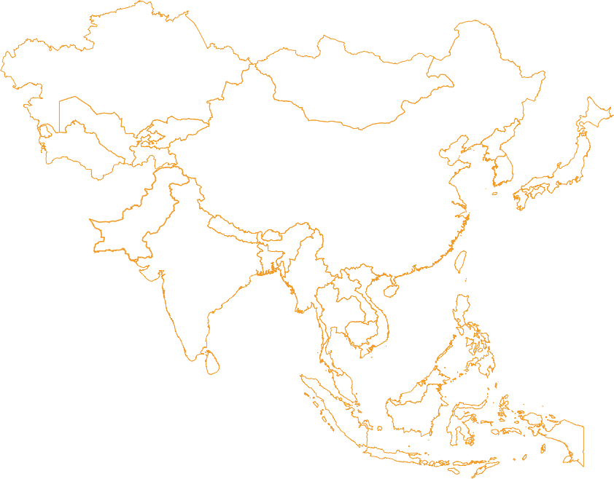
Have I not Sent You?
Judges 6:14 The Lord turned to him and said, “Go in this strength of yours and save Israel from the hand of Midian. Have I not sent you?”

Slide 2
CALLED WITH A PURPOSE

Slide 3
The Despair
Judges 6:3 Every time the Israelites would plant crops, the Midianites invaded Israel together with the Amalekites and other eastern nations. 4-5 They rode in on their camels, set up their tents, and then let their livestock eat the crops as far as the town of Gaza. The Midianites stole food, sheep, cattle, and donkeys. Like a swarm of locusts,[a] they could not be counted, and they ruined the land wherever they went.

Slide 4
Diligence
Judges 6:11 One day an angel from the Lord went to the town of Ophrah and sat down under the big tree that belonged to Joash, a member of the Abiezer clan. Joash’s son Gideon was nearby, threshing grain in a shallow pit, where he could not be seen by the Midianites.

Slide 5
The Spiritual Reality
Judges 6:12 The angel appeared and spoke to Gideon, “The Lord is helping you, and you are a strong warrior.”
13 Gideon answered, “Please don’t take this wrong, but if the Lord is helping us, then why have all of these awful things happened? We’ve heard how the Lord performed miracles and rescued our ancestors from Egypt. But those things happened long ago. Now the Lord has abandoned us to the Midianites.”

Slide 6
The Delegation
Judges 6:14 The Lord turned to him and said, “Go in this strength of yours and save Israel from the hand of Midian. Have I not sent you?”

Slide 7
Why are we here?
Judges 6:15 Gideon replied, “But how can I rescue Israel? My clan is the weakest one in Manasseh, and everyone else in my family is more important than I am.”

Slide 8
Have I not Sent You?

Slide 9
SENT: שָׁלַח shâlach, shaw-lakh'; a primitive root; to send away, for, or out (in a great variety of applications):—× any wise, appoint, bring (on the way), cast (away, out), conduct, × earnestly, forsake, give (up), grow long, lay, leave, let depart (down, go, loose), push away, put (away, forth, in, out), reach forth, send (away, forth, out), set, shoot (forth, out), sow, spread, stretch forth (out).

Slide 10
Sent
Isaiah 61:1 “The Spirit of the Lord God is upon Me, because the Lord hath anointed Me to preach good tidings unto the meek. He hath sent me to bind up the brokenhearted, to proclaim liberty to the captives, and the opening of the prison to them that are bound, 2 To proclaim the acceptable year of the Lord, and the day of vengeance of our God; to comfort all that mourn, 3 To appoint unto them that mourn in Zion, to give unto them beauty for ashes, the oil of joy for mourning, the garment of praise for the spirit of heaviness, that they might be called trees of righteousness, the planting of the Lord, that He might be glorified.”

Slide 11
Sent
Jer 1:7
But the LORD said unto me, Say not, I am a child: for thou shalt go to all that I shall send H7971 thee, and whatsoever I command thee thou shalt speak.

Slide 12
Sent
Romans 10:14 How then shall they call on Him in whom they have not believed? And how shall they believe in Him of whom they have not heard? And how shall they hear without a preacher? 15 And how shall they preach unless they are sent? As it is written: “How beautiful are the feet of them that preach the Gospel of peace, and bring glad tidings of good things!”

Slide 13
Sent
Psalm 127:4As arrows are in the hand of a mighty man, so are the children of the youth. 5 Happy is the man that hath his quiver full of them; they shall not be ashamed, but they shall speak with the enemies at the gate.

Slide 14
Sent
Matthew 10:5 These twelve Jesus sent forth, and commanded them, saying, Go not into the way of the Gentiles, and into any city of the Samaritans enter ye not
Matthew 10:7 And as ye go, preach, saying, The kingdom of heaven is at hand.

Slide 15
Sent
Matthew 10:8 Heal the sick, raise the dead, cleanse the lepers, cast out demons. Freely you have received, freely give.

Slide 16
Sent
Luke 10:1 After these things the Lord appointed seventy others also, and sent them two by two ahead of Him into every city and place whither He Himself would come.

Slide 17
Sent
Luke 10:9 And heal the sick that are therein and say unto them, ‘The Kingdom of God is come nigh unto you.’

Slide 18
Sent
3 John 1:2 Dear friend, I am praying that everything prosper with you and that you be in good health, as I know you are prospering spiritually.

Slide 19
Have I not Sent You?

Slide 20
Sent
3 John 1:2 Dear friend, I am praying that everything prosper with you and that you be in good health, as I know you are prospering spiritually.

Slide 21
The Ministries Sent
Ephesians 4:11 And he gave some to be apostles; and some, prophets; and some, evangelists; and some, pastors and teachers; 12 for the perfecting of the saints, unto the work of ministering, unto the building up of the body of Christ: 13 till we all attain unto the unity of the faith, and of the knowledge of the Son of God, unto a fullgrown man, unto the measure of the stature of the fulness of Christ:

Slide 22
Forgiveness of Sins
Matthew 9:2 Some people brought him a paralyzed man lying on a mattress. When Yeshua saw their trust, he said to the paralyzed man, “Courage, son! Your sins are forgiven.” 3 On seeing this, some of the Torah-teachers said among themselves, “This man is blaspheming!” 4 Yeshua, knowing what they were thinking, said, “Why are you entertaining evil thoughts in your hearts? 5 Tell me, which is easier to say — ‘Your sins are forgiven’ or ‘Get up and walk’? 6 But look! I will prove to you that the Son of Man has authority on earth to forgive sins.” He then said to the paralyzed man, “Get up, pick up your mattress, and go home!”

Slide 23
Forgiveness of Sins
Psalms 32:3 When I kept silence, my bones wasted away Through my [a]groaning all the day long. 4 For day and night thy hand was heavy upon me: My moisture was changed [b]as with the drought of summer. Selah 5 I acknowledged my sin unto thee, And mine iniquity did I not hide: I said, I will confess my transgressions unto Jehovah;And thou forgavest the iniquity of my sin.

Slide 24
Forgiveness of Sins
2 Samuel 12:5 David burned with anger against the man. “I solemnly swear, as the Lord lives,” he said to Nathan, “the man who did this certainly deserves to die! 6 And he must pay back four times the price of the lamb because he did this and had no pity.

Slide 25
Forgiveness of Sins
2 Samuel 12:13 Then David said to Nathan, “I have sinned against the Lord.” Nathan replied, “The Lord has taken away your sin; you will not die.

Slide 26
The Lord’s Supper
1 Corinthians 11:27 Therefore, whoever eats the Lord’s bread or drinks the Lord’s cup in an unworthy manner will be guilty of desecrating the body and blood of the Lord! 28 So let a person examine himself first, and then he may eat of the bread and drink from the cup; 29 for a person who eats and drinks without recognizing the body eats and drinks judgment upon himself. 30 This is why many among you are weak and sick, and some have died!

Slide 27
Anointing with Oil
James 5:14 Is someone among you ill? He should call for the elders of the congregation. They will pray for him and rub olive oil on him in the name of the Lord.

Slide 28
Anointing with Oil
Mark 6:13 They cast out many demons and anointed many sick people with oil and healed them.

Slide 29
Anointing with Oil
Numbers 3:3 These are the names of the sons of Aaron, the priests who were anointed, whom Aaron [a]consecrated and ordained to minister in the priest’s office.

Slide 30
Anointing with Oil
Psalm 89:20“I have found David My servant; With My holy oil I have anointed him,

Slide 31
Anointing with Oil
1 Peter 5:1 Now, I encourage you as an elder,[a] an eyewitness of the sufferings of Christ, and one who shares in the glory that is about to be unveiled. I urge my fellow elders among you 2 to be compassionate shepherds who tenderly care for God’s flock and who feed them well, for you have the responsibility to guide, protect, and oversee. Consider it a joyous pleasure[b] and not merely a religious duty. Lead from the heart under God’s leadership—not as a way to gain finances dishonestly but as a way to eagerly and cheerfully serve. 3 Don’t be controlling tyrants[c] but lead others by your beautiful examples to the flock.[d] 4 And when the Shepherd-King[e] appears, you will win the victor’s crown of glory that never fades away.[f]

